Slide 1

Predicting Default of Credit Card Clients
Abiola Ijaola
DATA606 Capstone
UMBC

Slide 2
Background
BSc. Mathematics / Statistics
Over 14 years Experience in Private and Public sector.

Slide 3
Why this project?
The historical data resources of the mining Department of Information Management, Chung Hua University, Taiwan and Department of Civil Engineering, Tamkang University, Taiwan promote the ability to build a predictive model to detect fraudulent activities.
In my experience, when evaluating fraudulent transaction, we leverage on advanced data science methodologies to identify patterns of fraudulent activities. This is important in measuring risk and risk metric helps in valuation of companies.

Slide 4
Literature Review
Author | Machine Learning Model | Number of Features | Number of Rows | Data period
I-Cheng Yeh, and Che-hui Lien (2007) | K-nearest neighbor classifier (KNN), Logistic Regression (LR), Discriminant Analysis (DA),Naïve Bayesian Classifier (NB), Artificial Neural Networks (ANN), Classification Trees (CT) | 23 | 5529 | 1987-2005
Several studies were researched but of all, this is the most relevant to what I’m working on.

Slide 5
There are two major findings from the literature Review
Probability of likelihood of default for its customers, as well as the identification of the key drivers that determine this likelihood.
Probability of default payments among mining methods.

Slide 6
Key Takeaway
The six major classification techniques in data mining (K-nearest neighbor, Logistic regression, Discriminant Analysis , Naive Bayesian, Neural networks and Classification trees) and its application on credit scoring were carefully considered in the paper.
The paper also compares the performance of classification and predictive accuracy of probability of default among the six techniques.
Artificial Neural Networks (ANN) was discovered to carry out classification more correctly than the other five methods. So it had better be use to score clients instead of the other techniques.

Slide 7
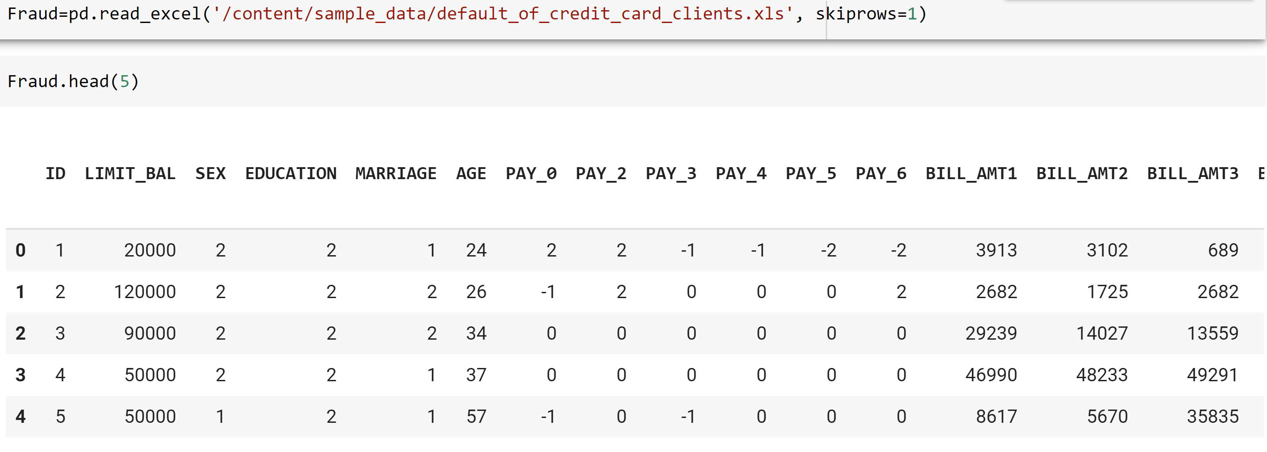
The Data
The dataset is collected from Department of Information Management, Chung Hua University, Taiwan and Department of Civil Engineering, Tamkang University, Taiwan.
The source URLs for the data is
https://archive.ics.uci.edu/ml/datasets/default+of+credit+card+clients.

Slide 8
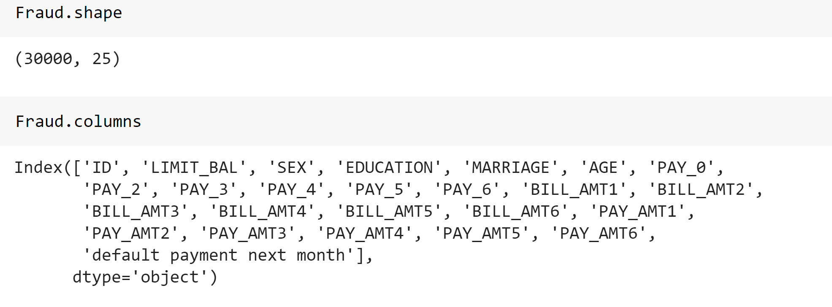
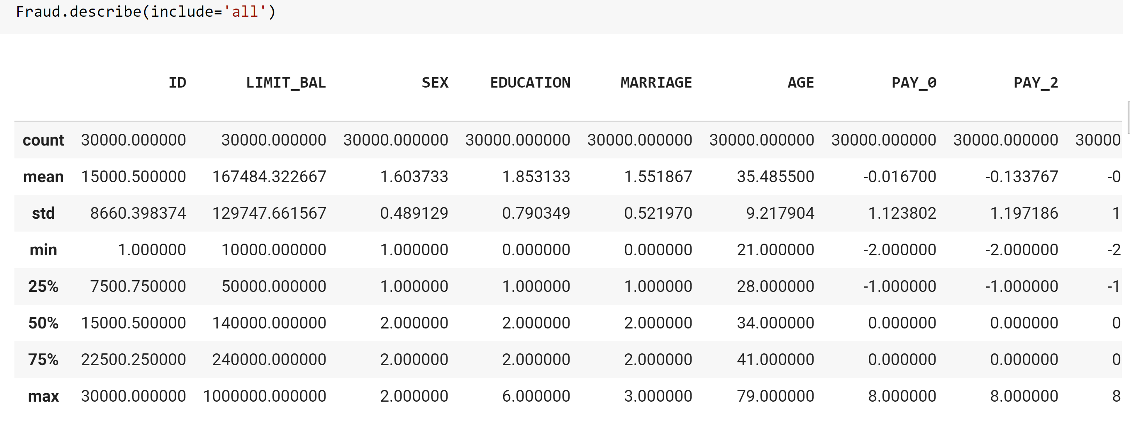
Preliminary Exploratory Data Analysis
First Look

Slide 9
Project Problem Statement
The project aims to answer the questions based on the 25 parameters case default payments in Taiwan. What is;
Probability of default payments?
Probability of default among data mining methods?
Probability of likelihood of default for its customers, as well as the identified key drivers that determine this likelihood.
The project will use Classification algorithms to learn from Taiwan dataset across different forecasting periods.

Slide 10
Process
Data Cleaning
Deal with Missing Values if any
Define data types for each column
Feature Engineering
Determine most relevant features
Develop synthetic features
Data Visualization
PCA
Determine whether Clusters exist
Model Training
Model Testing, Interpretation, and Evaluation
Choose three most relevant ML algorithms based on data characteristics
For each algo, develop 5 classifiers for the cases
Test and Interpret Models
Evaluate models
Compare Accuracy
Visualize trends and patterns
Understand the dataset

Slide 11
Next Steps
Finalize Data Exploration
Construct the model

Slide 12
References
1. Baesens, B., Setiono, R., Mues, C., & Vanthienen, J. (2003). Using neural network rule extraction and decision tables for credit-risk evaluation. Management Science, 49(3), 312–329.
2. Baesens, B., Van Gestel, T., Viaene, S., Stepanova, M., Suykens, J., & Vanthienen, J. (2003).
3. Benchmarking state-of-the-art classification algorithms for credit scoring. Journal of the Operational Research Society, 54(6), 627–635.
4. Berry, M., & Linoff, G. (2000). Mastering data mining: The art and science of customer relationship management. New York: John Wiley & Sons, Inc.
5. Chou, M. (2006). Cash and credit card crisis in Taiwan. Business Weekly, 24–27.

Slide 13
Thank you

